Slide 1

.
Present & Future Trends of Netflix OTT Platform

Slide 2

The Team
IBM Mentor
Ms. Jiljil Mathew
Edunet Mentor
Mr. Deepneel Majumdar
Student Team
Data Analytics Team 07
NSTI Bangalore

Slide 3





Workload Division
Himanshu
Data Visualization in Jupyter Notebook, Dashboard In Microsoft Power BI
Data Preparation in Jupyter Notebook, Dashboard In Microsoft Power BI
Data Collection, Documentation, Deployment
Documentation
J
.
GEETANJALI RAHEJA
NEERAJ KUMAR
t.
DEWESH KUMAR
.

Slide 4
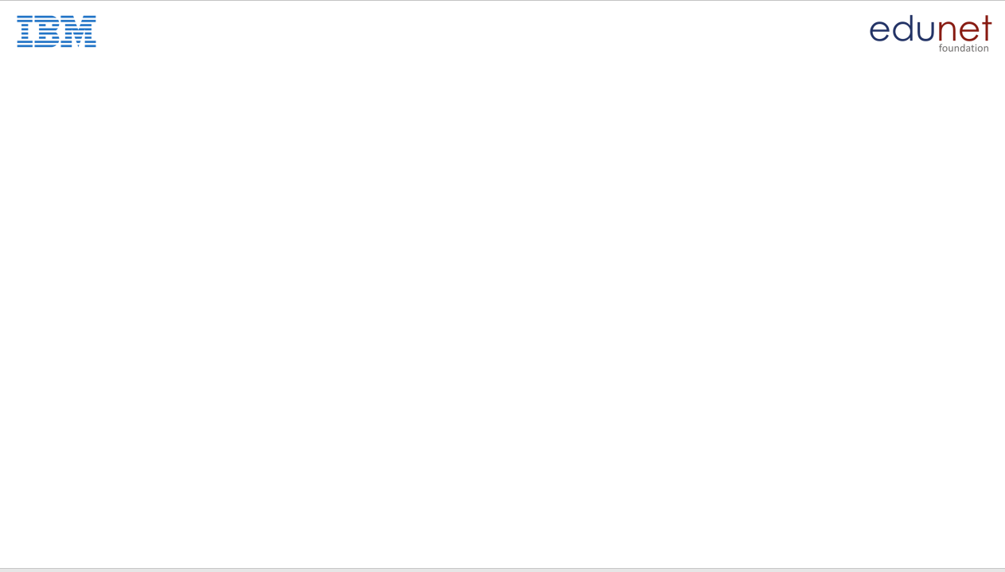
The Background
Began in 1997
Marc Randolph and Reed Hastings
Los Gatos,CA
1999-subscription
2007-streaming
2012-international
2013-Netflix Originals
2016-over 190 countries
2021-over 221 million paid subscribers.

Slide 5
Problem Statement
As many movies and series of different geners are being released on different platforms attracting many viewers, this is causing a competetion between the directors to direct which type of movie and where to stream it.
Most directors are unsure on what type of movies that can attract a large audience as there are no available platforms for them to look at. Without a proper insight, they may face a financial loss if the movie receives little to none viewers.

Slide 6
Proposed Solution
Proposed solution is, we are giving the recommended data through our analysis. So they understand which type of movies and shows are liked by people.
Through this data analysis Netflix and directors will be able to understand where they should invest more money and time in future for increasing their streaming.

Slide 7
Solution Design
DATA COLLECTION
DATA PRE-PROCESSING & CLEANING
DATA ANALYSIS & VISUALIZATION IN JUPYTER NOTEBOOK
DASHBOARD IN MICROSOFT POWER BI

Slide 8
Technology Stack & Requirements
Technology Stack
System Requirements
Software Requirements
Python & their libraries
1 GB Ram or above
2 GB Hard Disk or above
Intel i3 3rd generation or above
Processor bit size(32 bit/64 bit or above)
Operating System
Microsoft Power BI
Jupyter Notebook
Browser

Slide 9

Innovative Idea
Jupyter Notebook Deploy in Github
Microsoft Power BI file deploy

Slide 10
Outcomes
Top IMDB score movie or tv show is Joker movie.
Top Rotten Tomato score movie or tv show is spotlight movie.
Parasite movie is winning 300 award.
South Korea produce 81 movies etc.

Slide 11

Future Enhancements/Scope
Perform prediction analysis
AI recommending system

Slide 12


